Slide 1
Control Divergence and Memory coalescing

Slide 2
Objective
To learn to analyze the performance impact of control divergence
Boundary condition checking
Control divergence is data-dependent

Slide 3
Performance Impact of Control Divergence
Boundary condition checks are vital for complete functionality and robustness of parallel code
The tiled matrix multiplication kernel has many boundary condition checks
The concern is that these checks may cause significant performance degradation
For example, see the tile loading code below:
if(Row < Width && t * TILE_WIDTH+tx < Width) {
ds_M[ty][tx] = M[Row * Width + p * TILE_WIDTH + tx];
} else {
ds_M[ty][tx] = 0.0;
}
if (p*TILE_WIDTH+ty < Width && Col < Width) {
ds_N[ty][tx] = N[(p*TILE_WIDTH + ty) * Width + Col];
} else {
ds_N[ty][tx] = 0.0;
}

Slide 4
Two types of blocks in loading M Tiles
1. Blocks whose tiles are all within valid range until the last phase.
2. Blocks whose tiles are partially outside the valid range all the way
M
Type 1
TILE_WIDTH
Type 2

Slide 5
Analysis of Control Divergence Impact
Assume 16x16 tiles and thread blocks
Each thread block has 8 warps (256/32)
Assume square matrices of 100x100
There are 49 thread blocks (7 in each dimension)

Slide 6
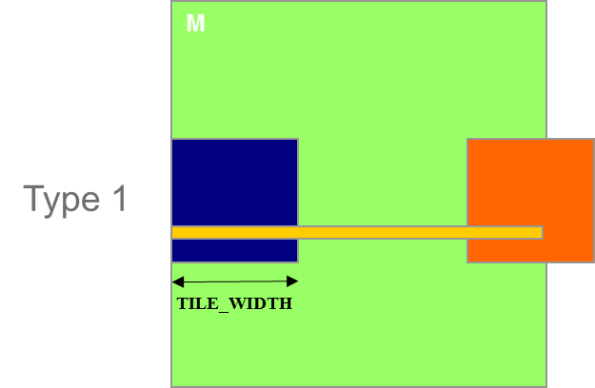
Control Divergence in Loading M Tiles
Assume 16x16 tiles and thread blocks
Each thread block has 8 warps (256/32)
Assume square matrices of 100x100
There are 42 (6*1) Type 1 blocks, with a total of 48 (8*6) warps
Only the warps on the edge of control divergence

Slide 7
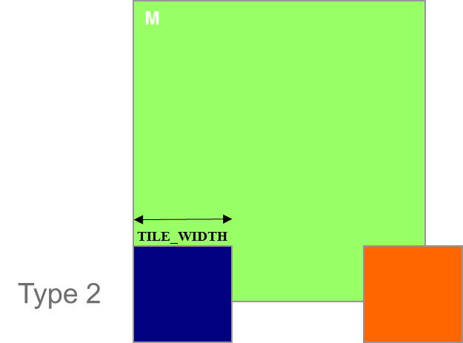
Control Divergence in Loading M Tiles (Type 2)
Type 2: the 7 block assigned to load the bottom tiles, with a total of 56 (8*7) warps
The first 2 warps in each Type 2 block will stay within the valid range until the last phase
The 6 remaining warps stay outside the valid range
So, only 2 warp have control divergence

Slide 8
Overall Impact of Control Divergence
Type 1 Blocks: 49 out of 392 warp-phases have control divergence
Type 2 Blocks: 2 out of 392 warp-phases have control divergence
The performance impact is expected to be ~13% (51/392)
M
Type 1
TILE_WIDTH
Type 2

Slide 9
Additional Comments
The estimated performance impact is data dependent.
For larger matrices, the impact will be significantly smaller
In general, the impact of control divergence for boundary condition checking for large input data sets should be insignificant
One should not hesitate to use boundary checks to ensure full functionality
The fact that a kernel is full of control flow constructs does not mean that there will be heavy occurrence of control divergence
We will cover some algorithm patterns that naturally incur control divergence (such as parallel reduction) in the Parallel Algorithm Patterns modules

Slide 10
Memory Coalescing
To learn that memory coalescing is important for effectively utilizing memory bandwidth in CUDA
Its origin in DRAM burst
Checking if a CUDA memory access is coalesced
Techniques for improving memory coalescing in CUDA code

Slide 11
DRAM Burst – A System View
Burst section
Burst section
Burst section
Burst section
0
1
2
3
4
5
6
7
8
9
10
11
12
13
14
15
Each address space is partitioned into burst sections
Whenever a location is accessed, all other locations in the same section are also delivered to the processor
Basic example: a 16-byte address space, 4-byte burst sections
In practice, we have at least 4GB address space, burst section sizes of 128-bytes or more

Slide 12
Memory Coalescing
Coalesced Loads
Coalesced Loads
T₀
T₁
T₂
T₃
T₀
T₁
T₂
T₃
0
1
2
3
4
5
6
7
8
9
10
11
12
13
14
15
Burst section
Burst section
Burst section
Burst section
When all threads of a warp execute a load instruction, if all accessed locations fall into the same burst section, only one DRAM request will be made and the access is fully coalesced.

Slide 13
Un-coalesced Accesses
Un-coalesced Loads
Un-coalesced Loads
T₀
T₁
T₂
T₃
T₀
T₁
T₂
T₃
0
1
2
3
4
5
6
7
8
9
10
11
12
13
14
15
Burst section
Burst section
Burst section
Burst section
When the accessed locations spread across burst section boundaries:
Coalescing fails
Multiple DRAM requests are made
The access is not fully coalesced.
Some of the bytes accessed and transferred are not used by the threads

Slide 14
How to judge if an access is coalesced?
Accesses in a warp are to consecutive locations if the index in an array access is in the form of
A[(expression with terms independent of threadIdx.x) + threadIdx.x];

Slide 15
A 2D C Array in Linear Memory Space
M_{0,0}
M_{0,1}
M_{0,2}
M_{0,3}
M_{1,0}
M_{1,1}
M_{1,2}
M_{1,3}
M_{2,0}
M_{2,1}
M_{2,2}
M_{2,3}
M_{3,0}
M_{3,1}
M_{3,2}
M_{3,3}
M
M_{0,0}
M_{0,1}
M_{0,2}
M_{0,3}
M_{1,0}
M_{1,1}
M_{1,2}
M_{1,3}
M_{2,0}
M_{2,1}
M_{2,2}
M_{2,3}
M_{3,0}
M_{3,1}
M_{3,2}
M_{3,3}
linearized order in increasing address

Slide 16
Two Access Patterns of Basic Matrix Multiplication
A
B
Thread 1
Thread 2
HEIGHT
WIDTH
A[Row*n+i]
B[i*k+Col]
i is the loop counter in the inner product loop of the kernel code
A is m $×$ n, B is n $×$ k
Col = blockIdx.x*blockDim.x + threadIdx.x

Slide 17
B accesses are coalesced
Load iteration 0
Load iteration 1
T₀
T₁
T₂
T₃
T₀
T₁
T₂
T₃
N
B_{0,0}
B_{0,1}
B_{0,2}
B_{0,3}
B_{1,0}
B_{1,1}
B_{1,2}
B_{1,3}
B_{2,0}
B_{2,1}
B_{2,2}
B_{2,3}
B_{3,0}
B_{3,1}
B_{3,2}
B_{3,3}
Access direction in kernel code
B_{0,0}
B_{0,1}
B_{0,2}
B_{0,3}
B_{1,0}
B_{1,1}
B_{1,2}
B_{1,3}
B_{2,0}
B_{2,1}
B_{2,2}
B_{2,3}
B_{3,0}
B_{3,1}
B_{3,2}
B_{3,3}

Slide 18
A Accesses are Not Coalesced
…
Load iteration 1
T₀
T₁
T₂
T₃
Load iteration 0
T₀
T₁
T₂
T₃
A_{0,0}
A_{0,1}
A_{0,2}
A_{0,3}
A_{1,0}
A_{1,1}
A_{1,2}
A_{1,3}
A_{2,0}
A_{2,1}
A_{2,2}
A_{2,3}
A_{3,0}
A_{3,1}
A_{3,2}
A_{3,3}
A_{0,0}
A_{0,1}
A_{0,2}
A_{0,3}
Access direction in kernel code
A_{1,0}
A_{1,1}
A_{1,2}
A_{1,3}
A_{2,0}
A_{2,1}
A_{2,2}
A_{2,3}
A_{3,0}
A_{3,1}
A_{3,2}
A_{3,3}

Slide 19
Loading an Input Tile
Have each thread load an A element
and a B element at the same relative
position as its C element.
B
Col
int tx = threadIdx.x
int ty = threadIdx.y
Accessing tile 0 2D indexing:
A[Row][tx]
B[ty][Col]
n
k
A
C
Row
m
m
WIDTH
n
k
Notes:
Point out that I and j will become global thread indices.

Slide 20
Corner Turning
d_M
d_N
Original
H
Access
T
D
I
Pattern
W
WIDTH
Copy into
shared
memory
d_M
d_N
Tiled
Access
Pattern
Perform
multiplication
with shared memory
values

